Slide 1



Milk, Feed, and MPP Margin Price Forecasting
John Newton
University of Illinois
jcnewt@illinois.edu
Chuck Nicholson
Penn State University
cfn10@psu.edu
@New10_AgEcon

Slide 2
What We Will Cover
Basic Background and information for MPP decisions
How the Decision Tool makes margin forecasts
Why margin forecasts should account for MPP impacts on margins
Selected margin forecasts over the current life of MPP (through 2018)

Slide 3

Basic Background and Information for MPP Decisions
Let’s get started…

Slide 4
MPP Margin Historical Perspective
Margin = U.S. All-Milk Price – NASS Corn Price x 1.0728 + AMS SBM x 0.00735 + NASS Alfalfa x 0.0137
2010
Secretary’s DIA Committee Recommends Margin Insurance
May 2011
Senate First Hearing on Farm Bill
2014 Farm Bill Dairy Production Margin
June 2009
$2.25/hundredweight
Source: USDA National Agricultural Statistics Service and Agricultural Marketing Service

Slide 5
Contribution to the MPP Ration

Slide 6
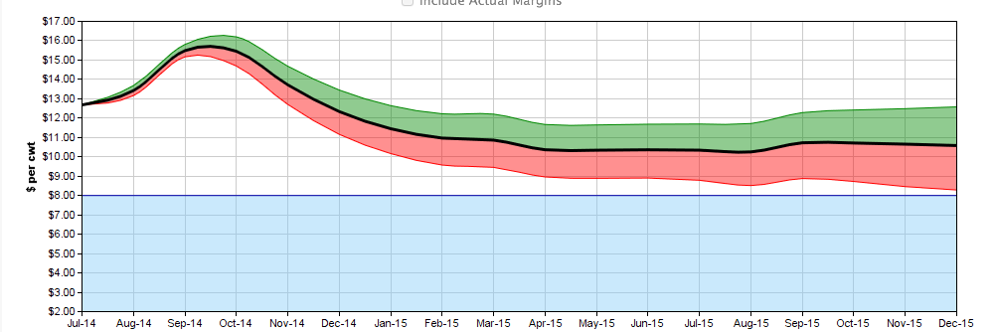
MPP: A New Way to Think About a Government Safety Net
Key farmer decisions:
How much milk to protect (25% to 90%)
What margin level to protect ($4 to $8)

Slide 7
Coverage Options*
Greater Protection at a greater cost
*113 Possible Coverage Choice Combinations

Slide 8
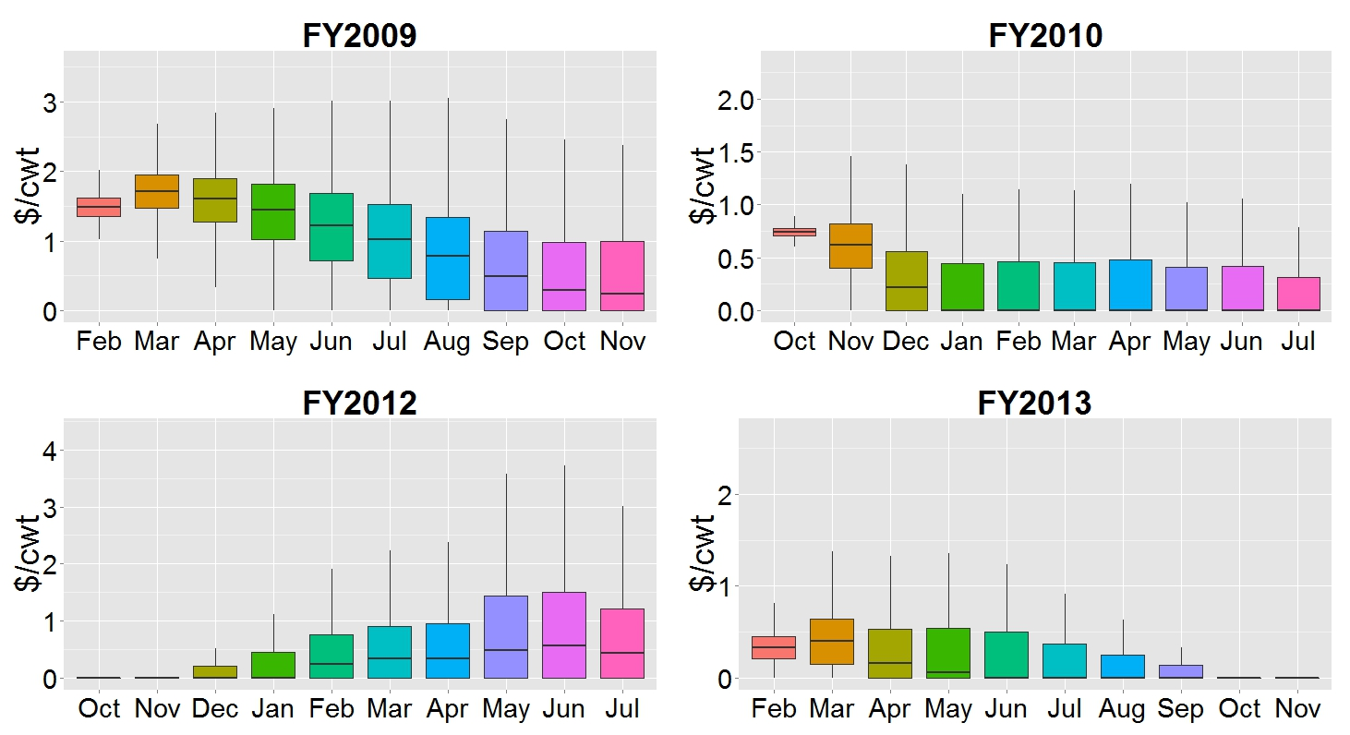
Expectations of MILC Payments (Using Futures Prices)
Start in March 2009
Start in October 2010
Start in
April – June 2012
Start in March 2013

Slide 9
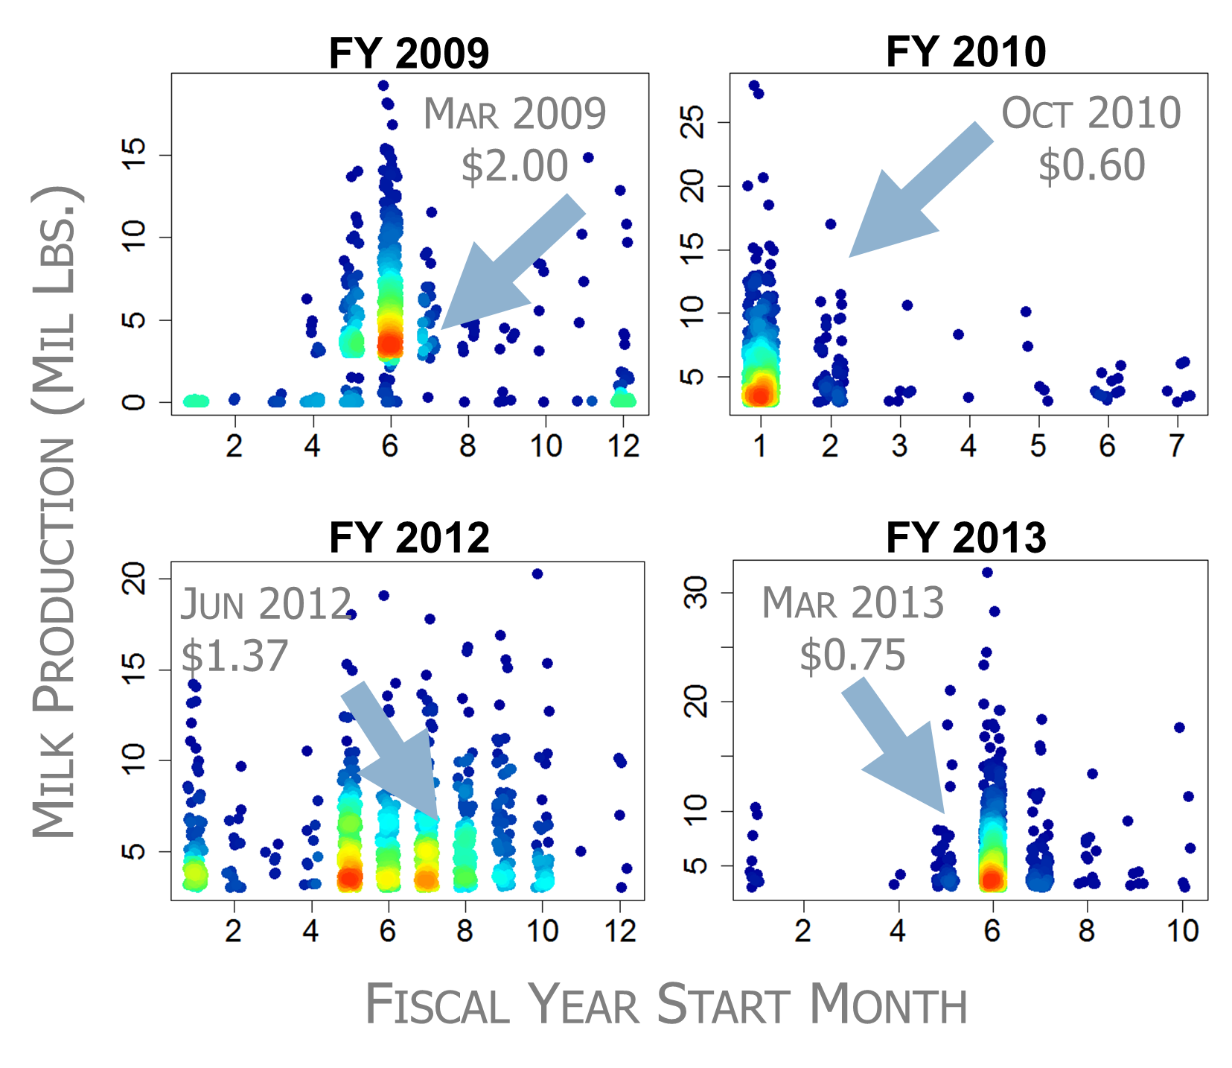
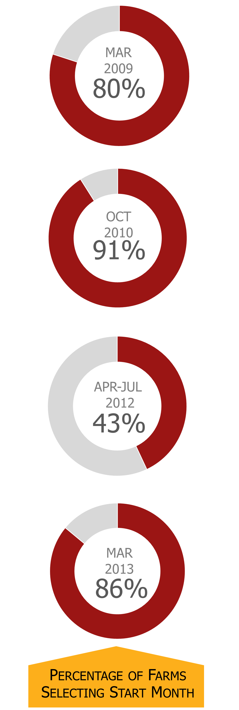
How Accurate Were Farmers?*
*Farms Marketing More than 3M #’s per month

Slide 10
Information Needed for MPP Decisions
Production history for a farm (one data point)
  Can be calculated with the tool
  Pretty straightforward
Expected MPP margin during covered period
  Not the margin for an individual farm (or its IOFC)
  Harder to predict but tool provides a range
  Requires a FORECAST of the MPP margin

Slide 11

Sources of Expected MPP Margin (Forecasts)
Cooperatives
Risk management firms
Academic “price” forecasters
Futures markets for milk and feed prices
Dart Board?

Slide 12
3 Characteristics of a Forecast
It will be wrong (there will be some error)
  So a range of values with likelihood is useful
It will be less accurate farther into the future (longer time horizon)
Multiple methods (forecasts) can be useful to give a range
  Analyzing market fundamentals (supply and demand)
  And are usually more accurate

Slide 13
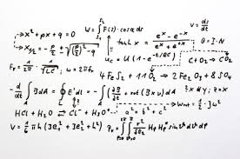
How the Decision Tool Makes Margin Forecasts
It’s really very simple…

Slide 14
Tool Margin Ranges are Based on Futures Markets
Economists think of futures markets as the “best available forecast”
  Many players have skin in the game
  Futures are generally considered to be unbiased estimators of future price
    Not consistently off in one direction or the other

Slide 15
Using CME to Forecast NASS Corn

Slide 16
Using CME to Forecast AMS SBM

Slide 17
Using CME to Forecast AMS All-Milk

Slide 18
Regression Price Inputs and Outputs
US All Milk Price
Class III Milk, Class IV Milk, Lagged Prices, Seasonal Dummy
US Corn Price
CME Corn, Lagged Prices
US Alfalfa Hay Price
NASS Corn, AMS Soybean Meal, US All Milk Price, Lagged Prices
AMS Soybean Meal
CME Soybean Meal Prices

Slide 19
Are Corn & SBM Prices Correlated?
SBM Price
Increases
Corn Price
Increases
Corn Price
Decreases
SBM Price
Decreases

Slide 20
Are Milk & Corn Prices Correlated?
Feed Price
Increases
Milk Price
Decreases
Milk Price
Increases
Feed Price
Decreases

Slide 21
Are Milk & SBM Prices Correlated?
Feed Price
Increases
Milk Price
Decreases
Milk Price
Increases
Feed Price
Decreases

Slide 22
Example Probabilities CME Feed
CME futures and options prices provide a forecast of the expected price and uncertainty

Slide 23
Example Probabilities CME Feed
Simulate from CME corn and soybean meal price distributions to get NASS and AMS prices

Slide 24
Example Probabilities CME Milk
Simulate from CME class III/IV milk price distributions to get NASS all-milk price

Slide 25
CME Probabilities Combined
Class III
Corn
Class IV
SBM

Slide 26
September 2015 MPP-Margin
Generate a probability distribution of MPP-Dairy Margin (for all coverage months)

Slide 27
MPP-Margin Forecast 9/8/14
2015 Forecast

Slide 28
MPP-Margin Forecast 9/8/14
2015 Forecast

Slide 29
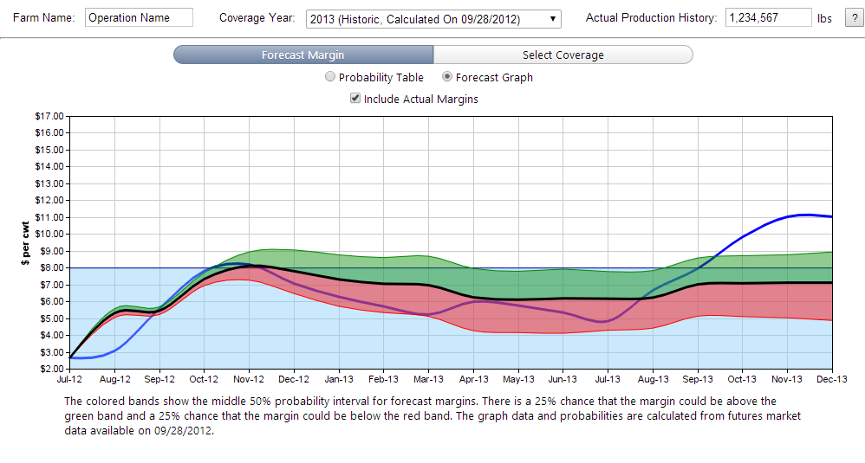
Tool Users Can Evaluate Historical Accuracy of Forecast
6 out of 7 years MPP Decision Tool Correctly Forecast Positive Net Returns to MPP Participation

Slide 30
Alternative Forecast Values Can Be Entered in the Tool
Economists think of futures markets as the “best available forecast”
  Many players have skin in the game
  But it is not completely accurate as a forecast
Alternative forecast values can be entered in an “Advanced” version of the tool
  Soon to be linked to this tool version

Slide 31
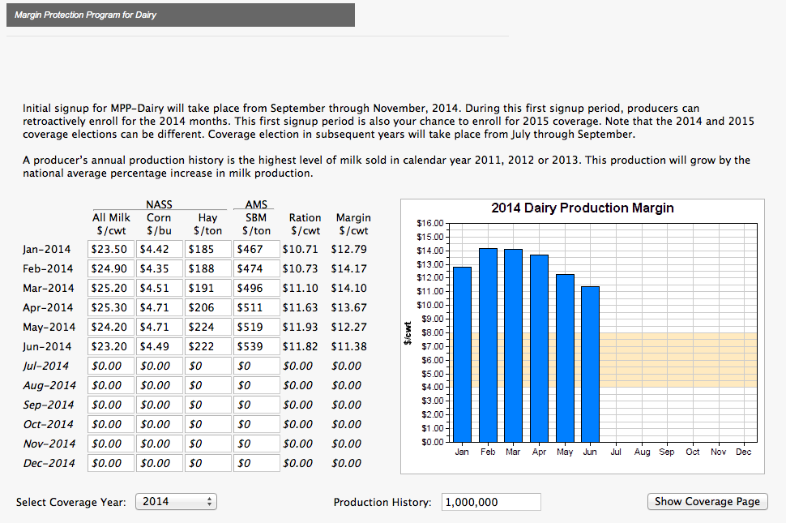
Alternatives to Futures Markets Margins in “Advanced” Tool
Automatically enters the relevant milk and feed prices for MPP margin formula when known

Slide 32
Alternatives to Futures Markets Margins in “Advanced” Tool
Advanced users can enter their own forecast values for the MPP margin calculation components*
*Must be use to use the correct national values

Slide 33

Why Margin Forecasts Should Account for MPP Impacts
The MPP rock in the margin pond?

Slide 34
Information Needed for MPP Decisions
Production history for a farm (one data point)
  Can be calculated with the tool
  Pretty straightforward
Expected MPP margin during covered period
  Not the margin for an individual farm (or its IOFC)
  Harder to predict but tool provides a range
  Requires a FORECAST of the MPP margin

Slide 35
A Complication: MPP Is Likely to Decrease Margins
The MPP works in a way that will lower margins if the program is active
  It will slow the adjustment of milk production during low price/margin periods
  Risk reduction enhances supply
This could complicate the development and use of margin forecasts

Slide 36
Simulated MPP Margin, 2015-2018
Average MPP decreases $0.91/cwt, margin < $8 most of time

Slide 37
A Complication: MPP Is Likely to Decrease Margins
Margins are likely to be lower with MPP
How much lower depends on producer participation
  Limited coverage, limited impacts
  Widespread coverage, larger impacts

Slide 38
Impacts of MPP Participation Levels on the MPP Margin
MPP participation decisions will affect the MPP Margin

Slide 39
Will MPP Margins Forecasts Account for MPP Impacts?
Our decision tool uses futures markets
  But this would apply to other forecasts also
Unclear to what extent forecasts will account for impacts of MPP if the program is likely to be active
Participation decisions are not known prior to completion of sign-up for a given coverage period
If do not account for MPP impacts, then margin forecasts will be “too high”

Slide 40
Implications of Ignoring MPP Impacts on Margins
If markets do not account for MPP impacts, then margin forecasts will be “too high”…
Could result in less coverage than is desired..
Or a decision not to participate…
With potentially sizeable impacts on farm income…

Slide 41
Impacts of MPP Participation on Net Farm Operating Income, 2015-2018
Simulation results suggest lower incomes if farms do not participate in MPP if active

Slide 42
Two Implications
Forecasted MPP margins should account for the participation decisions of farmers (if the program is likely to be active)
Expected participation decisions of producers collectively could (should) influence the decisions of an individual producer

Slide 43
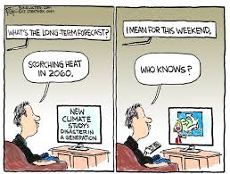
Selected Margin Forecasts Over the Current Life of MPP
A longer-term perspective…

Slide 44
Longer-Term Perspective on Margins
During 2005 to 2013, we did not see 4 consecutive years with margins always > $8
Suggests that MPP may become active in the future, despite current high margins

Slide 45
Longer-Term Perspective on Margins
May be helpful to future decision making
  When to register for MPP?
  Rule out program participation early on?
What are projections over the life of the MPP program?
Two examples: statistical and simulation
  Not a component of the decision tool, but food for thought

Slide 46
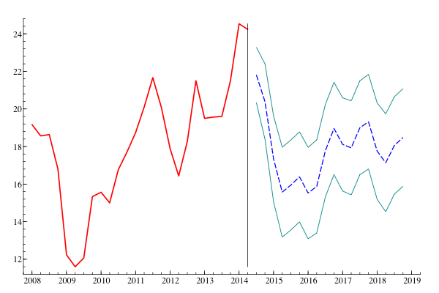
Statistical Forecast of All-Milk Price (Quarterly through 2018)

Slide 47
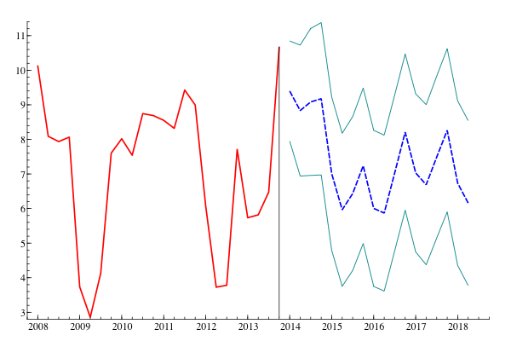
Statistical Analysis of MPP Margin through 2018

Slide 48
Simulation Model Projections for 2015-2018
An alternative to statistical projections
Dynamic dairy supply chain model
Assumes feed prices, simulates all-milk price
Calculates margin based on milk and feed prices

Slide 49
Simulated Milk Price and Margin Values, 2015-2018

Slide 50
Simulation Model Implications
Low price period projected in 2016
Low margin period projected in 2016
  Program could become active
This is a forecast and will be wrong
  Does not provide the correct future values
  Pattern of behavior more likely to be correct

Slide 51
Key Points
MPP decisions should be informed by expected margins (margin forecasts)
  Which should account for the impacts of the program
Decision tool provides one source of this information, including range of values
  Based on futures markets
  But others are likely to be available

Slide 52
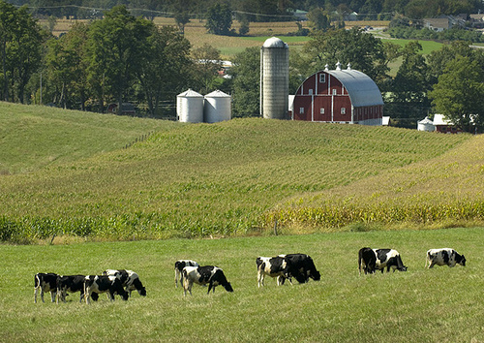
Questions or Comments?

